Slide 1

Group 1
Capstone Project

Slide 2
Assignment Brief
Amazon hosts millions of products across multiple categories, each competing for visibility, sales, and customer engagement. Understanding what drives product performance such as pricing, discounts, ratings, and category dynamics is important for sellers and business analysts. In this project, you are required to perform a comprehensive Exploratory Data Analysis (EDA) on the Amazon Product Dataset to uncover hidden patterns, trends, and actionable insights that explain product performance on the platform.

Slide 3
1. Major product categories on Amazon and number of per category

Slide 4
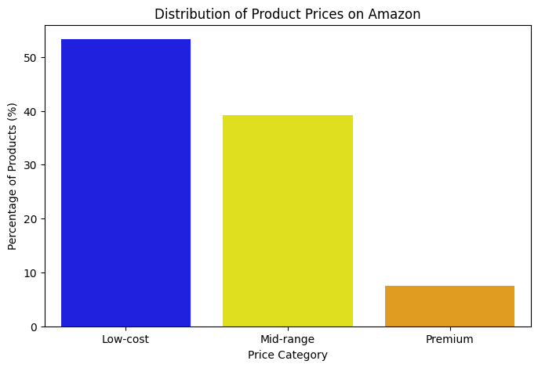
2. Distribution of product prices by category (low-cost, mid-range, or premium)
# | Price category | Product count | Percentage share
0 | Low-cost |  | 53.3
1 | Mid-range | 559105 | 39.2
2 | Premium | 107181 | 7.5

Slide 5
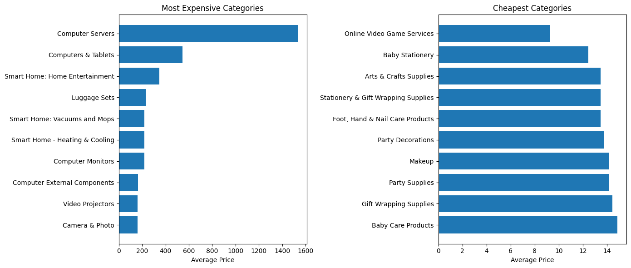
3. Highest average prices and Cheapest

Slide 6
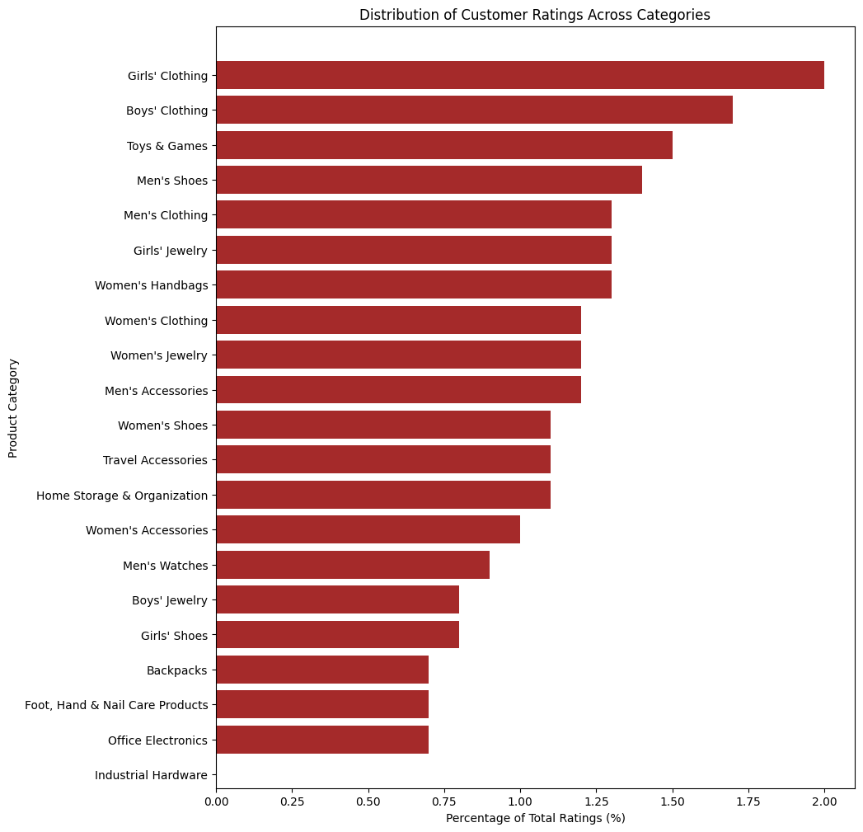
4. Customer ratings across product categories

Slide 7
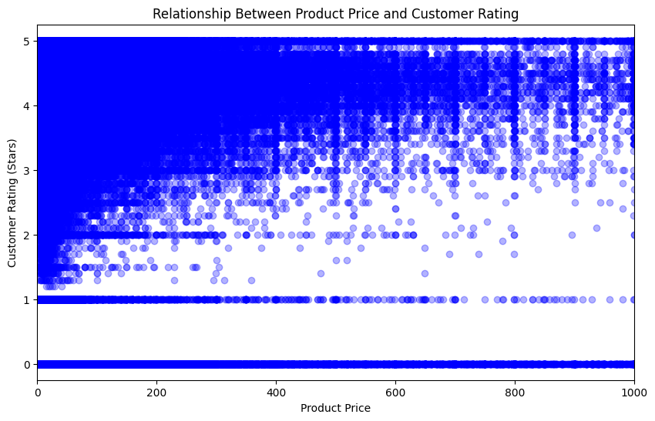
5. Relationship between product price and customer rating
Do expensive products receive better ratings?
Correlation between price and rating: -0.08

Slide 8
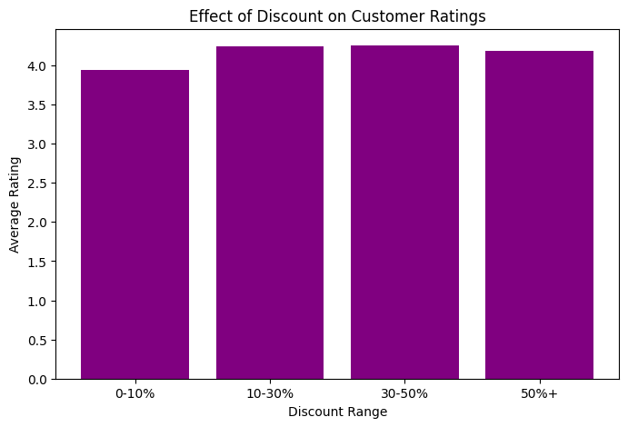
6. Effect of discount on customer ratings

Slide 9
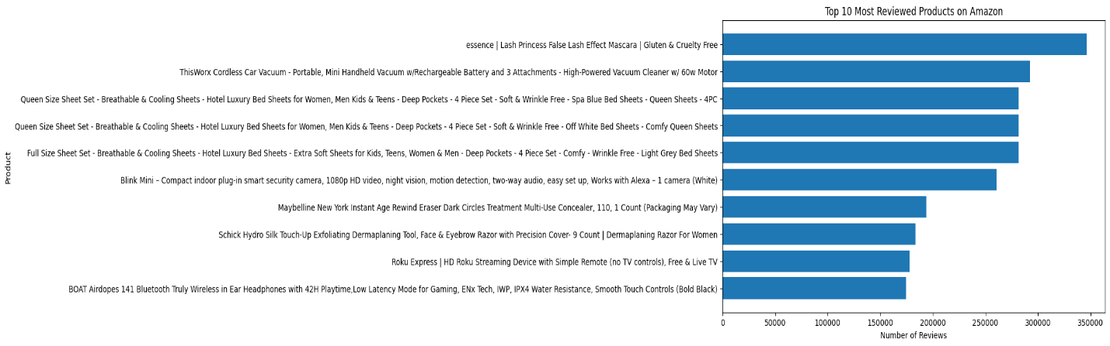
7. Products and categories with highest number of reviews and implications on demand?
Top 10 products

Slide 10

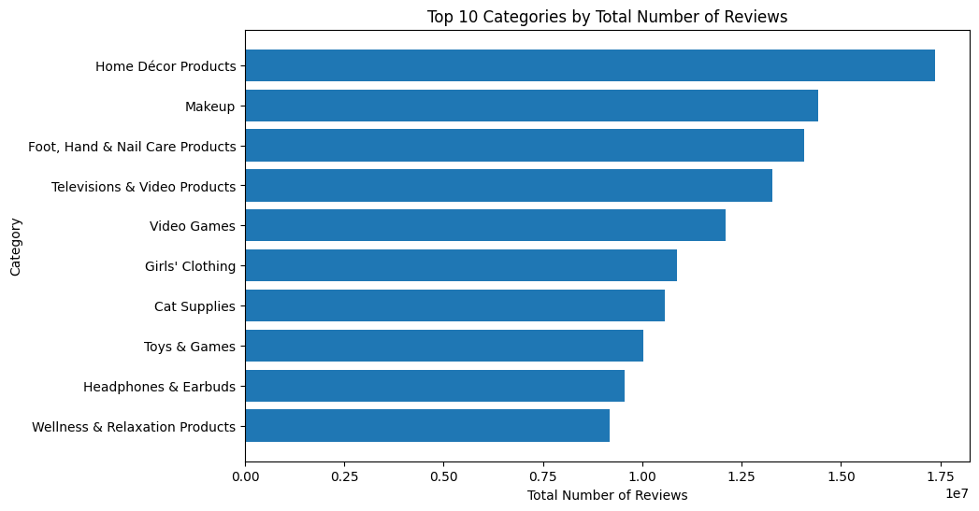
7. Products and categories with highest number of reviews and implications on demand?
Top 10 Categories

Slide 11
8. Review and Prices of high rated products
High rating, low reviews

Slide 12
8. Review and Prices of high rated products
High reviews, low rating

Slide 13
8. Review and Prices of high rated products
High rating, expensive

Slide 14
Actionable recommendations For Sellers:
Pricing:
Compete aggressively in low-cost segments, but don’t ignore mid-range and premium opportunities.
Price competitively, but ensure value is clear at every price point.
Discounts:
Use discounts strategically to boost engagement and reviews but focus on sustainable value and customer experience for long-term success.

Slide 15
8. Review and Prices of high rated products
High rating, cheap

Slide 16
9. Top-performing products based on stars, reviews, and price

Slide 17
9. Actionable recommendations can be made to sellers based on pricing, discounts, and category focus
Insights Question 1 From the dataframe above we can see the major categories of product that were bought by customers were girls and boys clothing with toys following closely. Also we can note that amongst the top ten major categories, fashion items are the top product categories Question 2 Insights: The analysis shows that the products in Amazon are dominantly low-cost, which account for over 53% of the products pricing. Mid-range products make up about 39%, while premium-priced items represent only 7.5% of the platform. This indicates that the platform features a higher concentration of affordable products, while premium offerings represent a smaller share of the overall marketplace.

Slide 18
9. Actionable recommendations can be made to sellers based on pricing, discounts, and category focus
Insights Question 3 Insights: The analysis shows that technology-oriented categories such as Computer Servers, Computers & Tablets, and Smart Home entertainment products are the highest priced products on Amazon. In contrast, categories like Online Video Game Services, Baby Stationery and Arts & Crafts Supplies are among the cheapest. This highlights a clear pricing divide between high-value equipment-based products and low-cost consumable or digital items. Question 4 Insights: Customer ratings are heavily concentrated in high-turnover categories such as clothing and toys, while niche or higher-priced categories receive far fewer ratings. This long-tail distribution indicates that customer engagement is driven more by purchase frequency than by product price, highlighting the importance of ratings management for competitive categories.

Slide 19
9. Actionable recommendations can be made to sellers based on pricing, discounts, and category focus
Insights Question 5 Insights: The correlation between product price and customer rating is -0.08, which is very close to zero. This indicates that there is virtually no linear relationship between how expensive a product is and how highly it is rated. In other words, higher-priced products are not necessarily better rated, and cheaper products can receive equally high ratings. Question 6 By grouping products into discount ranges, we can see how customer ratings vary with discount levels. If the bar chart shows relatively similar average ratings across all discount categories, it indicates that offering larger discounts does not necessarily lead to higher customer ratings. Conversely, if higher discounts have higher average ratings, it may suggest that discounts slightly improve customer perception or satisfaction, but this should be interpreted carefully alongside other engagement metrics. From the visuals, we can see that The correlation between discount percentage and customer ratings is 0.078, which is very close to zero. This indicates a very weak positive relationship — meaning that higher discounts barely influence customer ratings. In other words, giving bigger discounts does not significantly make customers rate products higher.

Slide 20
9. Actionable recommendations can be made to sellers based on pricing, discounts, and category focus
Insights Question 7 Insights: “Highly reviewed products are mainly everyday essentials, electronics, and personal care items, showing strong customer engagement. Categories such as Home Décor, Makeup, and Foot & Hand Care dominate total reviews, indicating concentrated demand. Overall, popularity is driven more by usefulness and appeal than price, reflecting a long-tail pattern of engagement across categories.” Question 8 Insights: This analysis reveals that product quality, popularity and price do not always align, highlighting hidden high-quality products, popular but mediocre items and premium offerings that require better market visibility.

Slide 21
9. Actionable recommendations can be made to sellers based on pricing, discounts, and category focus
Insights Question 9 Insight: The combined performance metric reveals that high-priced premium electronics dominate overall rankings, indicating that revenue potential outweighs popularity and even perfect customer ratings in determining top-performing products.

Slide 22
Conclusions
General Advice:
Prioritize product quality and customer satisfaction over price alone.
Monitor and respond to customer feedback to improve ratings and reviews.
Benchmark against top-performing products and categories to refine your strategy.

